Slide 1

Data Visualization
Group 7
Group Project by:
Lucas Guilhot
Aishwarya Menon
Shankar Baskaran
Surabhi Chavan
Shreenidhi Sriram
Notes:
https://unsplash.com/photos/hKzmPs8Axh8
Lucas Guilhot
Raphael Hermes
Alexander Holzwarth
Azma Khan
Shreyas More

Slide 2
Project group description
Group project: show the impact of the vaccination on the COVID-19 pandemic by taking the US as an example
Main hypothesis:
Is covid vaccination effective to fight Covid 19 in different states of United States of America?
Sub hypothesis:
Is covid vaccination reducing confirmed positive cases in different states of the US?
Is covid vaccination reducing deaths in different states of the US?
Notes:
Please add photo source

Slide 3


2 Datasets
Kaggle
State by state daily data on COVID-19 vaccinations in the United States
Github
State by state daily data of COVID-19 positive cases and deaths in the US
2,600 records after cleaning
Tool used :
Notes:
Please add photo source

Slide 4
1) Correlation between vaccination, deaths and cases
Notes:
Please add photo source

Slide 5
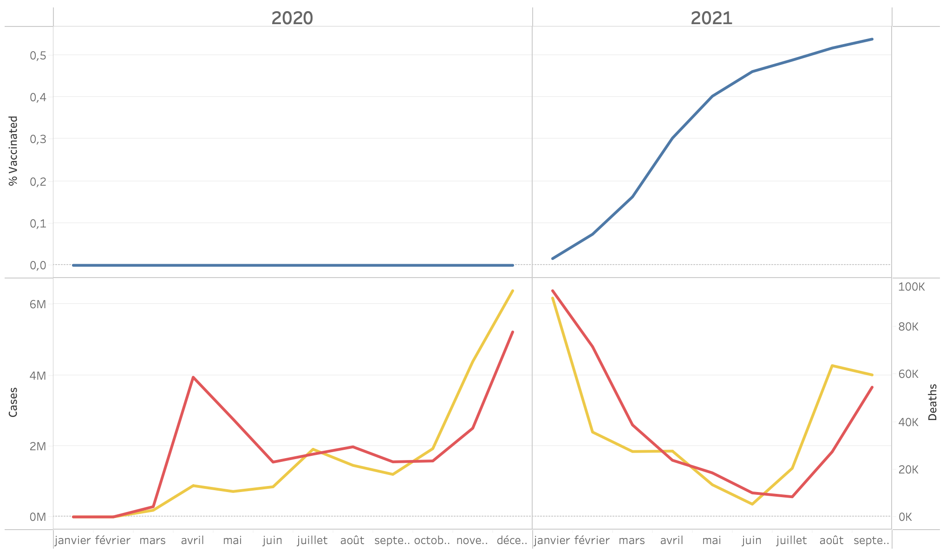
Overall Situation: % vaccination, cases and deaths in the US
Beginning of vaccination
Delta variant arrives in the US
Notes:
Please add photo source

Slide 6
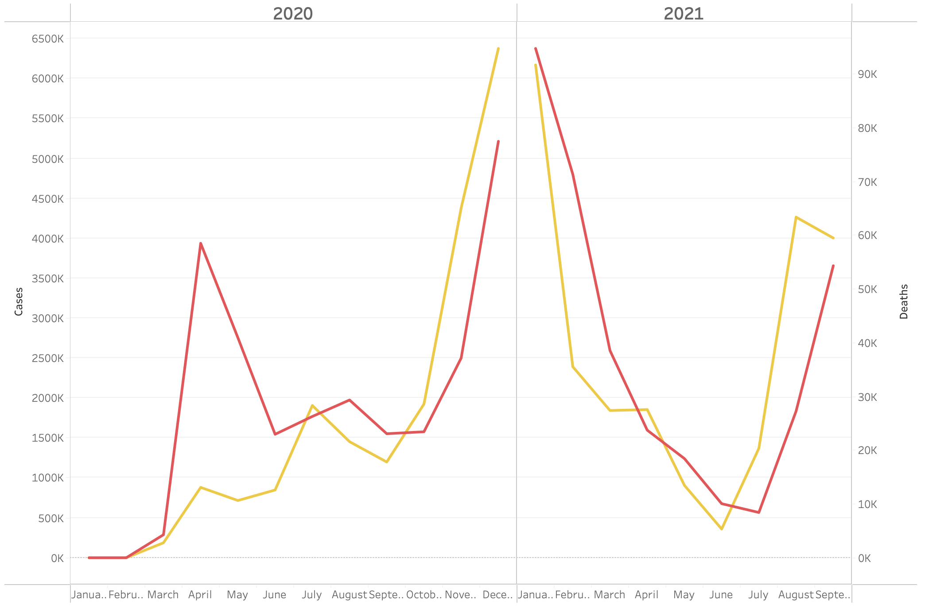
Cases and deaths trend
Beginning of vaccination
Delta variant arrives in the US
Notes:
Please add photo source

Slide 7
High VS low percentage vaccination: California VS Texas
California
Texas
Notes:
Please add photo source

Slide 8
Conclusion
#1 conclusion
#2 conclusion
…

